Slide 1



Development of a COMSOL Breast FEM Model for the Early Warning Scan
08-07-2026
Daan Kuijpers | Internship project | Catharina Hospital | April – July 2026
COMSOL FEM Breast Model for Early Warning scan

Slide 2
Why Breast Screening Matters
2.3 million breast cancer diagnoses worldwide [1]
Early detection increases treatment options
Screening aims to detect disease before symptoms visible
Mammography is established, but not perfect
Notes:
Breast cancer remains one of the most common cancer worldwide, with more than 2.3 million new cases reported annually
This makes screening and early detection important → aims to detect disease before symptoms become clinically visible, the earlier the more treatment options are available and treatment can
Mammography is currently used as golden standard for screening for breast cancer, but it has its limitations

Slide 3
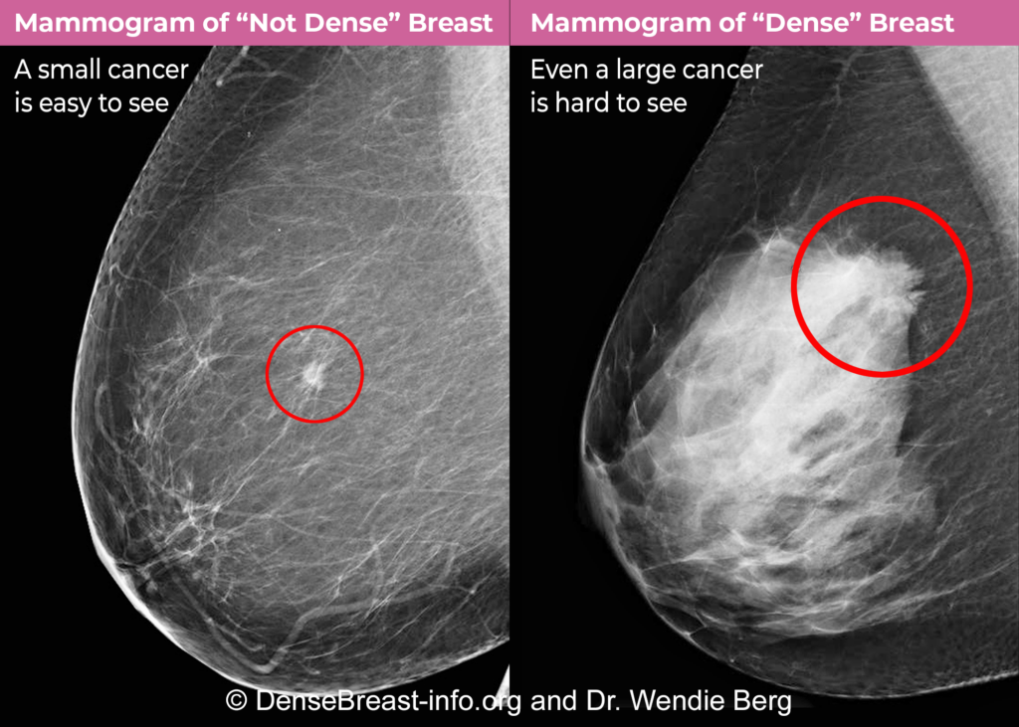
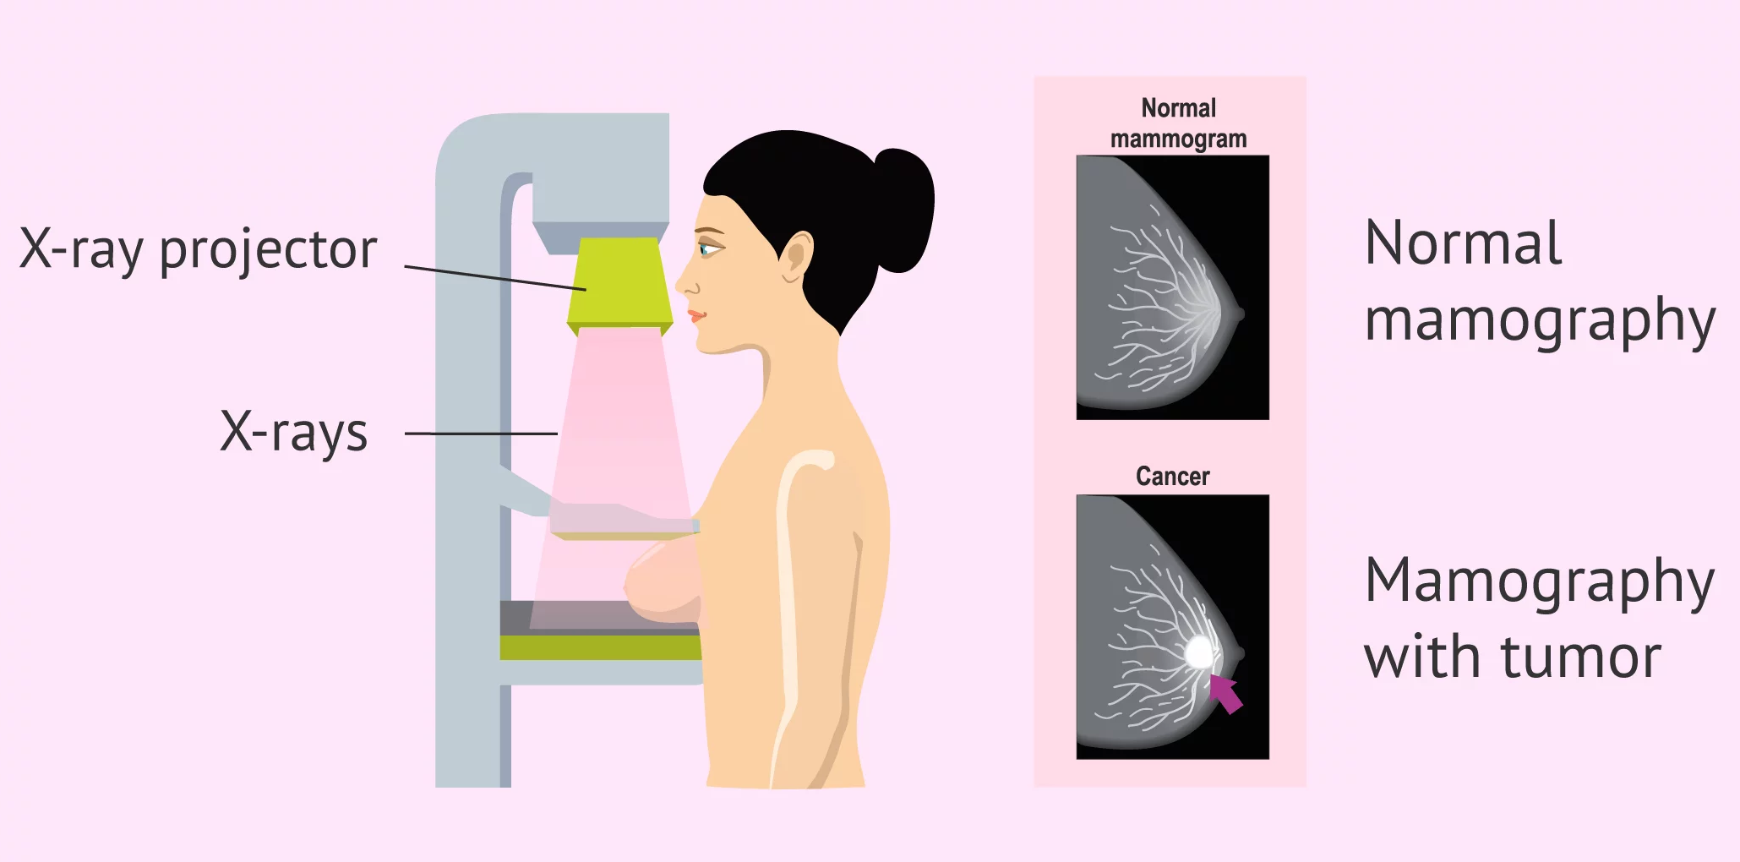
Limitations of Mammography
Radiation exposure
Discomfort
High costs
Reduced sensitivity in dense tissue
[2] Dr. Wendie Berg [3] inviTRA
Notes:
X-rays are used to make the breast images, which exposes the patient to radiation
During mammography, the breast is compressed between plates to improve image quality, but it can be uncomfortable or painful for some patients. (now 30% of women do not take part in screening)
Costs are still relatively high for mammography
A major limitation is reduced sensitivity in dense breasts. Dense fibroglandular tissue and tumors can both appear relatively bright on a mammogram, which makes abnormalities harder to distinguish. This is one of the reasons why other screening methods are being investigated.

Slide 4
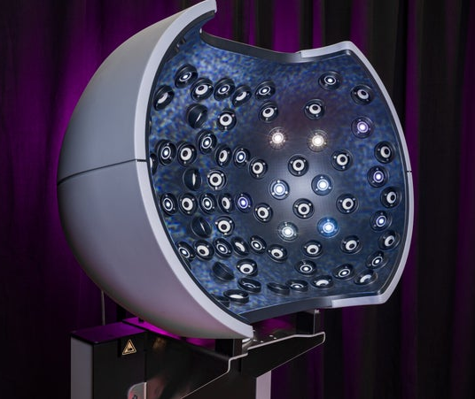

The Early Warning Scan
Markerless optical surface measurement
No radiation or compression
Deformation responses
FEM
[4] Early Warning Scan
Notes:
The Early Warning Scan is based on optical measurement of the breast surface.
Instead of using X-rays or contact-based imaging, the system uses cameras and projected light patterns to reconstruct the breast surface. Which makes it a lot more comfortable for women.
The scan is not only interested in a static breast shape, but also during motion, so that the dynamic deformation response can be analysed.
Designed to detect these biomechanical differences caused by internal tissue changes such as a tumor which is stiffer than normal breast tissue which makes the breast surface look and move differently.
FEM is used to understand which internal changes could be visible at the surface
No ionizing radiation or compression:
A key motivation is that the method is intended to avoid ionizing radiation and breast compression. This makes it conceptually different from mammography. However, this does not mean it is already a replacement for mammography; it is still a technique under development.
FEM needed to interpret deformation patterns:
The surface motion measured by EWS depends on anatomy, material properties, support conditions and loading. A finite-element model is therefore useful to understand which model components influence the surface response, and whether local stiffness changes could theoretically affect measurable motion.

Slide 5
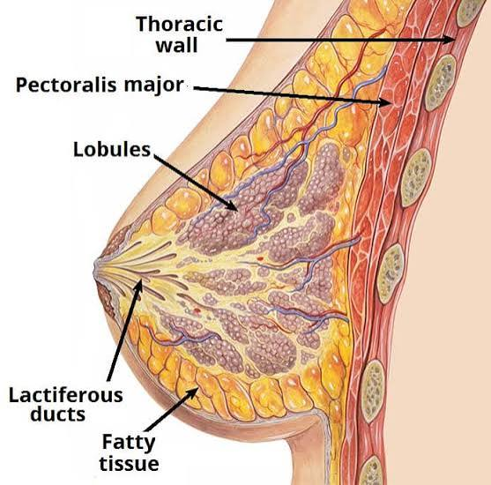
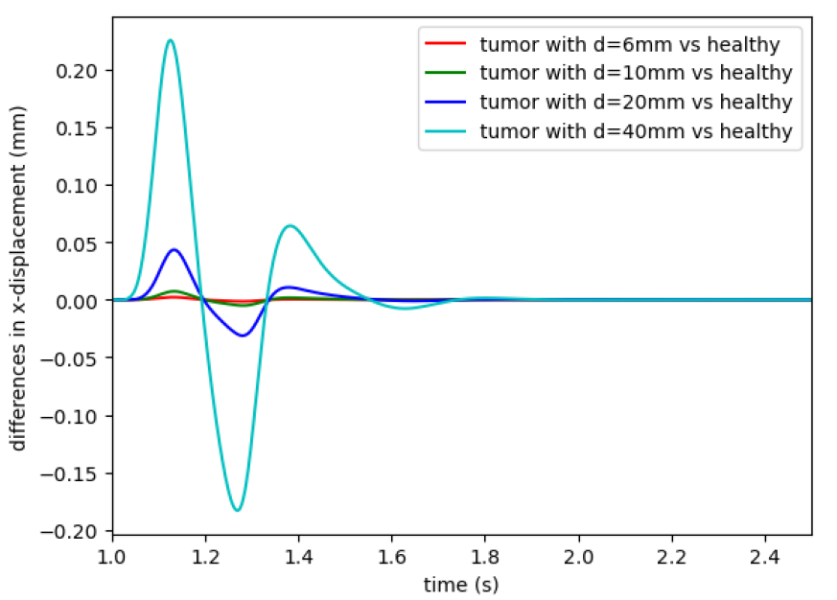
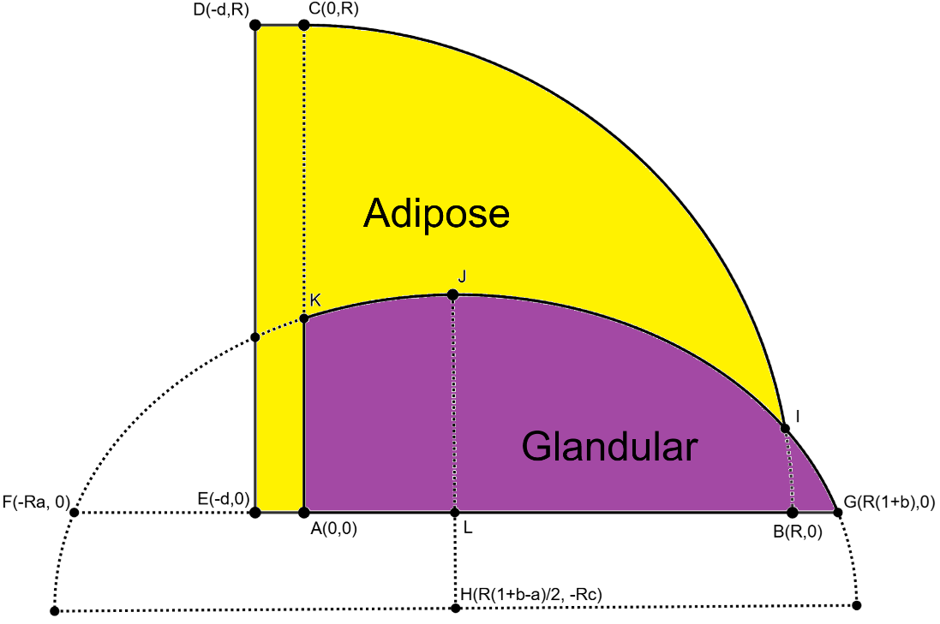
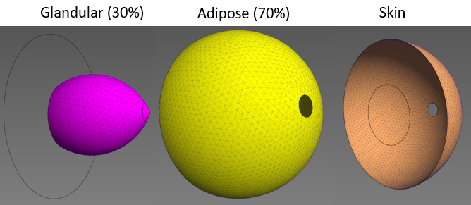
Previous work
[5] TeachMeAnatomy
Notes:
Before this project, an simplified FEM model was already created. It used an adipose and glandular region which are rotated to form the breast model. But this model is still a simplified version of the breast when looking at breast anatomy
This previous work showed already some promising displacement responses.

Slide 6
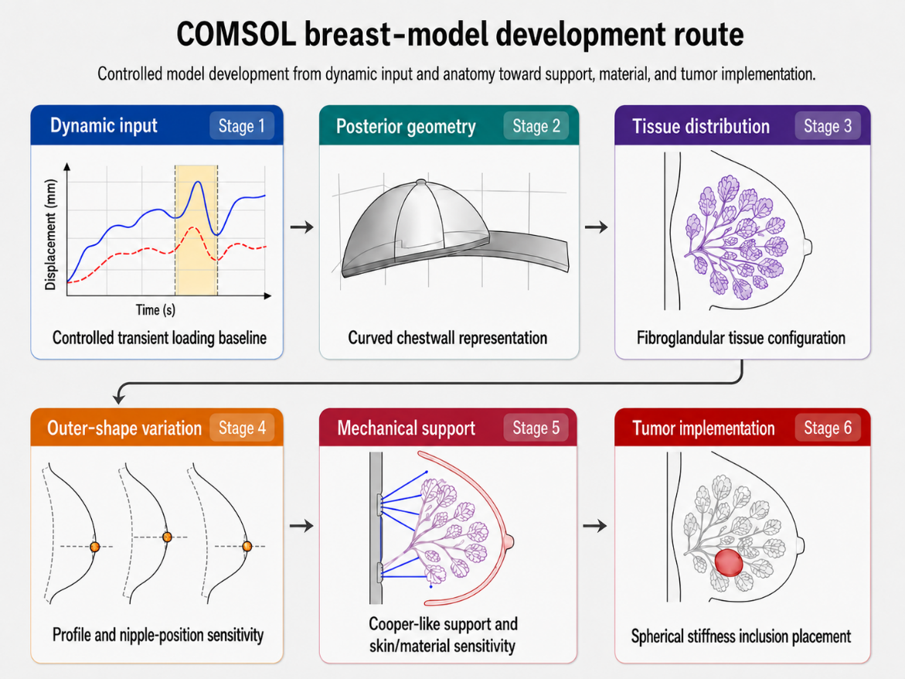
Project Aim and Scope
Making a more realistic FEM breast model
Anatomical definitions
Mechanical support
FEBio → COMSOL
Notes:
The main aim of this project was to build a more realistic FEM breast model which can be used to validatie the EWS concept.
The project focused on improving both the anatomical parts of the model and the mechanical support defined in the model. This included: picture
The earlier EWS models were developed in a program called FEBio. For this project, I moved to COMSOL because it offered a more practical environment for building larger more realistic model variants, which in FEBio were unable to solve.

Slide 7
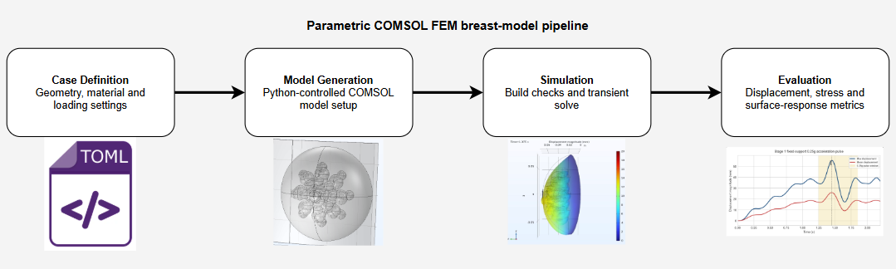
COMSOL pipeline
Notes:
- Case Definition: This contains the main geometry, material, loading and evaluation settings. In my project these settings were stored in TOML files, so each model variant could be traced back to a specific input case.
- Model Generation: The case definition is then translated into a COMSOL model setup. The goal was to reduce manual editing in COMSOL and make the model variants more reproducible.
- Simulation: After the model is generated, the simulation is built and solved in COMSOL.
- Evaluation: Finally, the outputs are post-processed into compact metrics and figures. The main focus was displacement, stress and surface-response metrics.

Slide 8
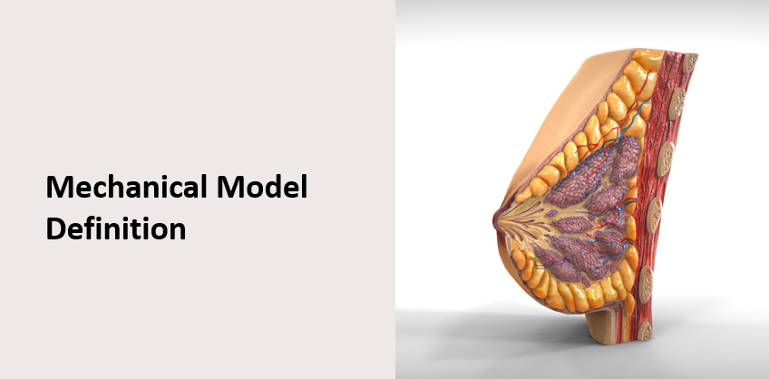
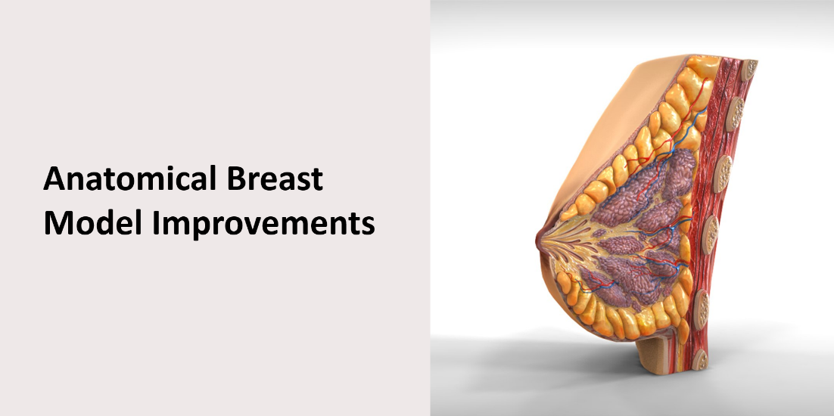
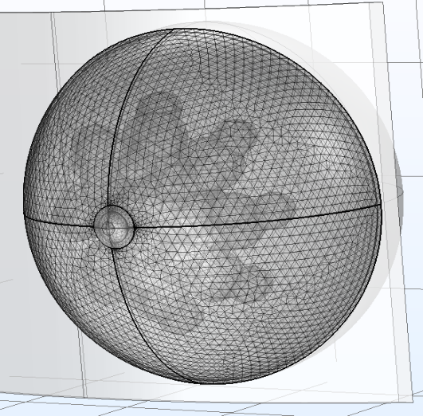
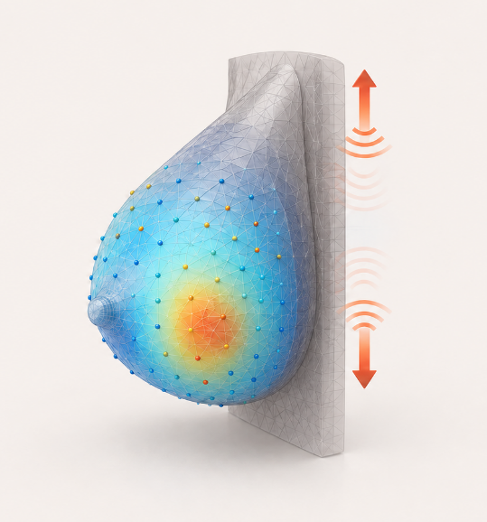
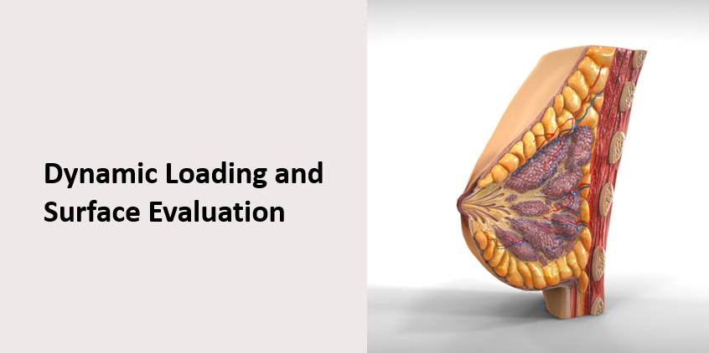
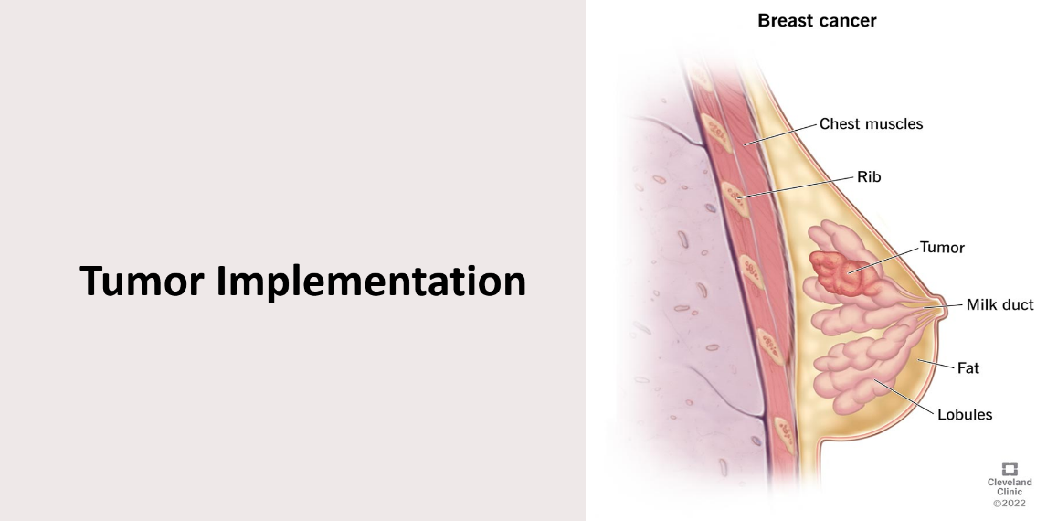
Notes:
- I will tell about the improvements in 4 divided subjects:…

Slide 9
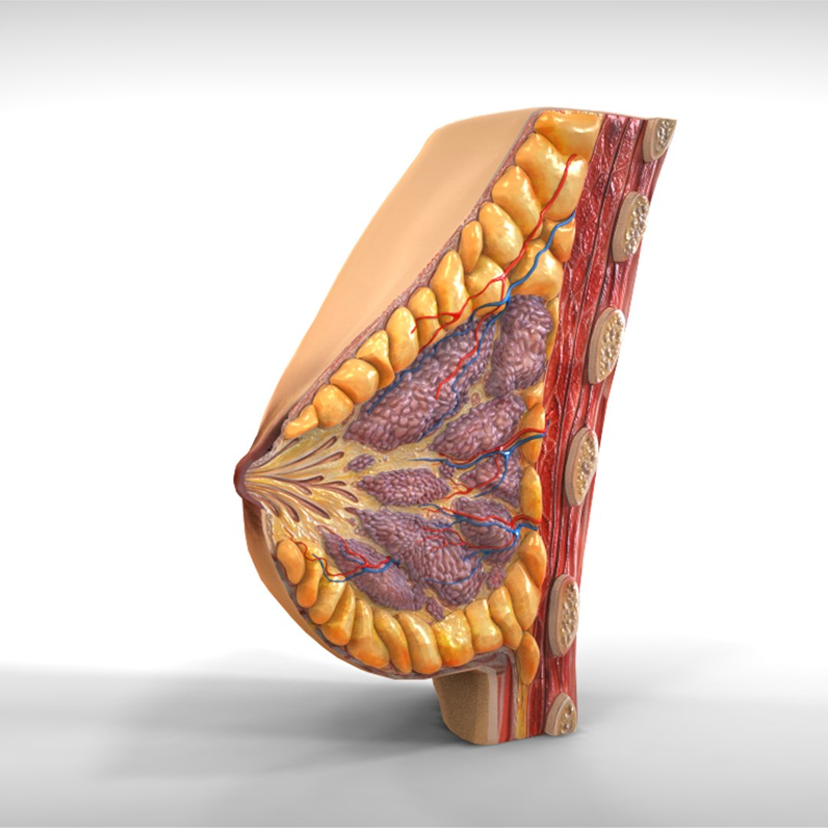
Anatomical Breast Model Improvements

Slide 10
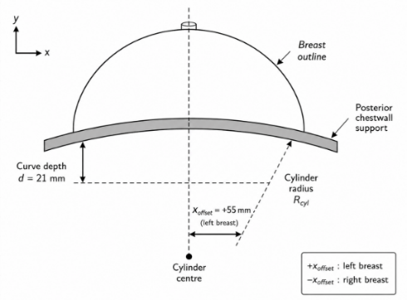
Chest wall Geometry
Curved posterior support
Transversal
Sagittal
Cilinder
Curve radius
X-offset (-/+)
Volume preserving
585 ml
+55mm transverse-offset
Notes:
Transverse and/or Sagittal chest wall curvature in model
Chest wall curvature is treated as patient-dependent sensitivity
Cilinder with a certain radius and an x-offset which can be used to represent a left or right breast
When varying these settings, the breast volume stays the same to make model comparison fair
I used the +55 mm transverse-offset variant as the reference and kept the reference route transverse curve only, because the breast is most curved in that way and a sagittal curve had not that much affect of the displacement since it’s only a light curve and only increasing complexibility.

Slide 11
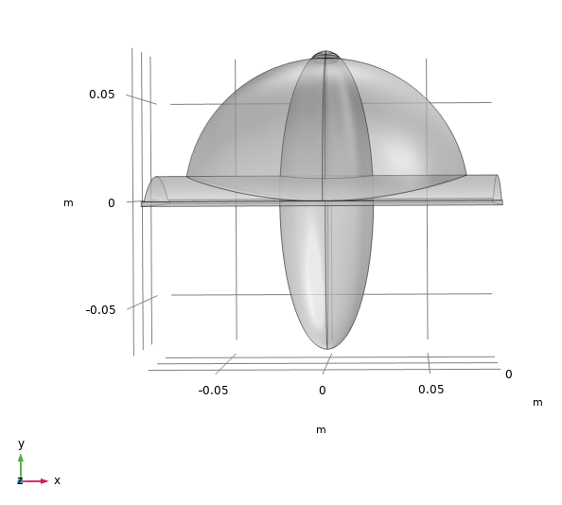
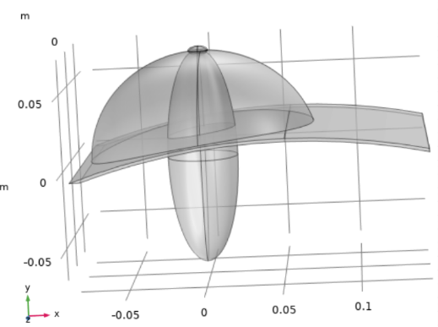
Chest wall Geometry
Superior views:
Sagittal curve Transversal curve (left breast)
Notes:
- Here are two examples of how it looked like when first implemented in the model.

Slide 12
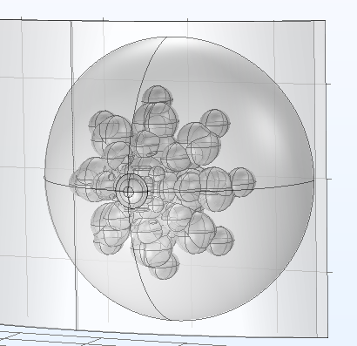
Glandular Distribution
Realistic glandular region
12 Lobules
Chestwall-aware placement
Fraction (%)
High → less displacement
Different spreads
Notes:
8-outer and 4-inner lobules, which is based on a realistic lobule amount according to literture
Glandular region adjusts with chestwall curvature
Adjustable Fraction and with a higher fraction the breast showed less displacement, because glandular tissue is slighty stiffer than fat tissue
And different type of spreads can be used

Slide 13
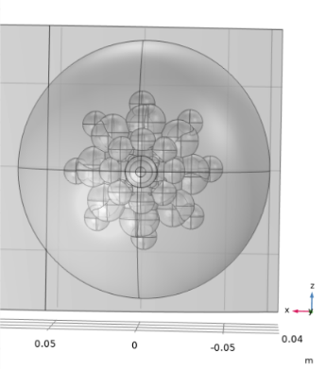
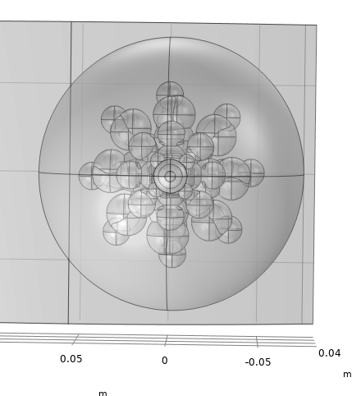
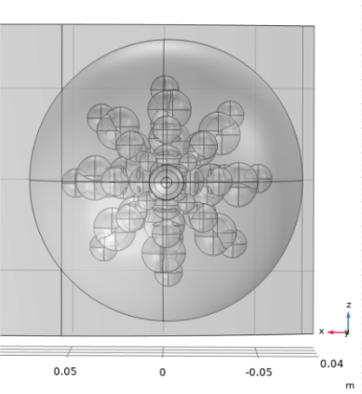
Glandular Distribution
Spreads: Compact Reference Wide

Slide 14
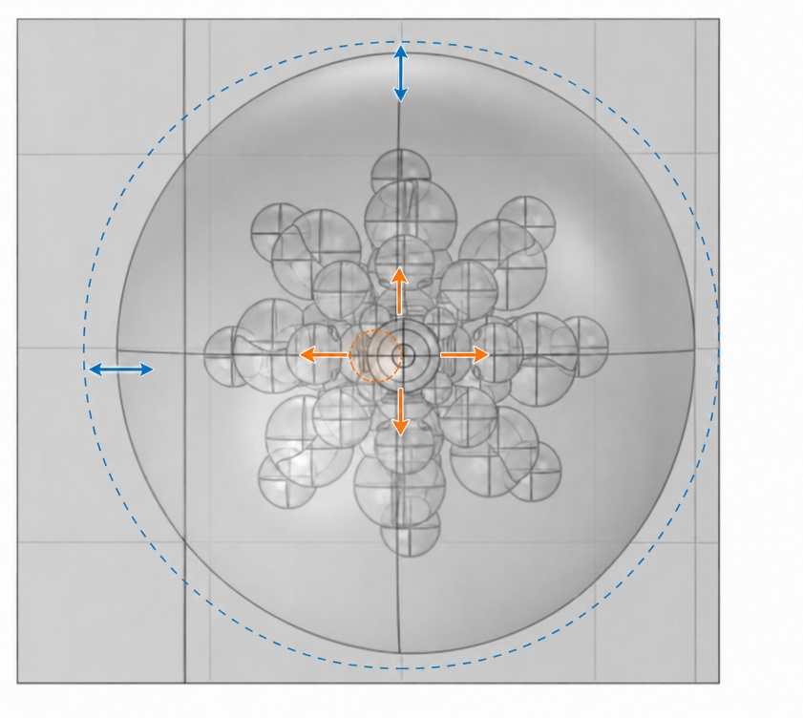
Asymmetry and Shape Variations
Outer-shape variants
Nipple-position variants
Reference model
Patient-specific shape variation
Notes:
The breast is for most women not perfectly symmetric, so I introduced some asymmetry variations
Profile asymmetry and nipple-shift variants are geometry-tested
All these anatomical improvements can be useful for later patient-specific shape variation

Slide 15
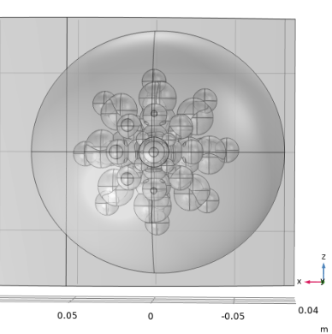
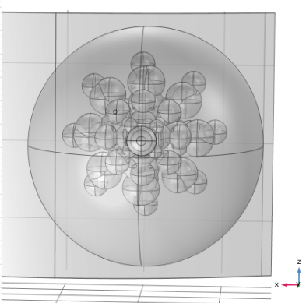
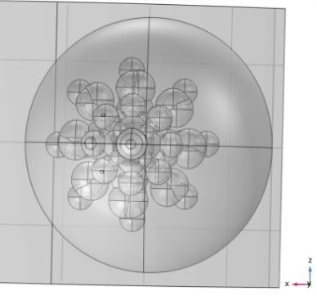
Asymmetry options
Examples: Width stretch Nipple changes

Slide 16
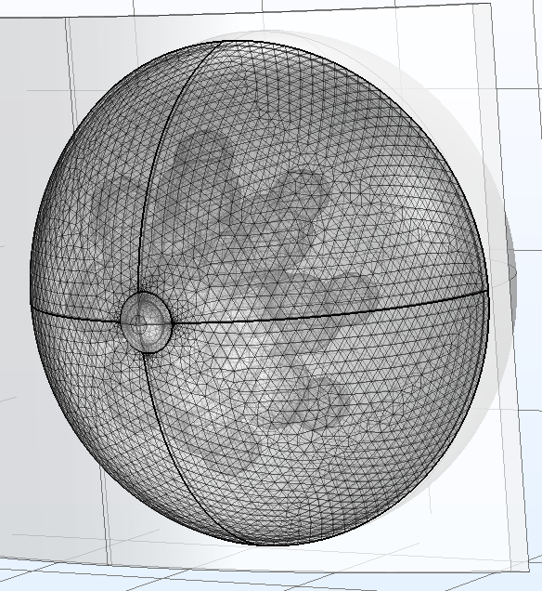
Mechanical Model Definition

Slide 17
Mesh
Free tetrahedral mesh
Settings:
Ls = 0.005 [m]
Density = 140 [m^-1]
Kept constant
Notes:
The COMSOL model was meshed using a free tetrahedral mesh. This is suitable for the 3D breast geometry, because the model contains curved surfaces, which
For the reference model, I used a characteristic mesh length of 5 mm. This was selected as a practical balance between geometric detail and computational cost, because they become more expensive for finer meshes.
The same mesh settings were kept across comparable model variants

Slide 18
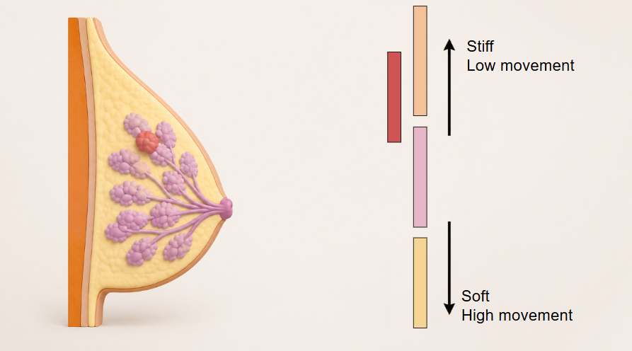
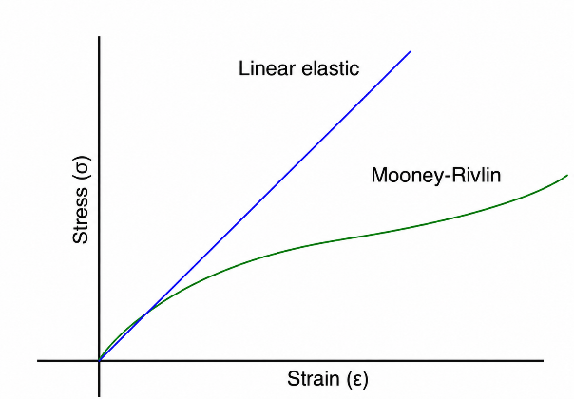
Material Definitions
Literature-based reference values
Large variation between studies
Sensitivity cases
Mooney-Rivlin
Non-linear deformation soft-tissue
Notes:
- The material parameters were selected from literature values.
The key point is that breast tissue material properties vary strongly in the literature. I therefore did not treat one parameter set as the true patient-specific value, but as a controlled reference set.
The model used Mooney-Rivlin to define the tissues. Instead of assuming a constant linear stiffness, it describes how soft tissue stores energy during deformation. In my model, C10 and C01 define the shear stiffness scale, while the last term controls the resistance to volume change.

Slide 19
Material Parameter Overview
Component | Literature stiffness range | Reference values used
Adipose (fat) tissue | Low-kPa range ~[0.5 – 25] kPa | 3.7 kPa
Fibroglandular tissue | Broad kPa range, most low kPa ~[0.08 – 272] kPa | 10 kPa
Skin layer | Very broad kPa range, most high kPa ~[20 – 3000] kPa | 14.4 kPa ; 88 kPa ; 500 kPa
Tumor | Depends on type of tumor ~[10 – 200+] kPa | 100 kPa
Notes:
- In table reference parameters used for most of the model tests - Ranges of skin and tumor were the broadest

Slide 20
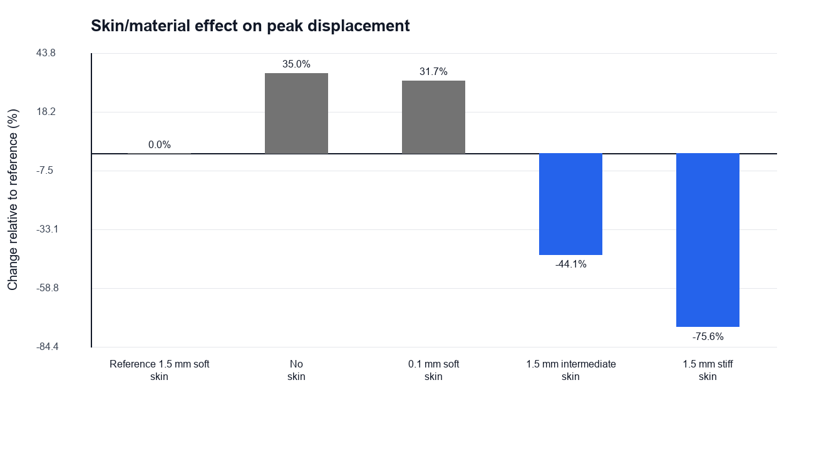
Skin Layer
1.5mm Volumetric skin layer
Stiffer outer model component
Strong effect on displacement
Types | Stiffness
Soft | 14.3 kPa
Intermediate | 88 kPa
Stiff | 500 kPa
Notes:
The skin was implemented as a 1.5 mm volumetric layer around the breast.
It acts like a stiffer outer model component.
Solving some different sensitivity cases with different parameter settings in the literature range I saw a lot of difference in response.
The different stiffnesses are from 3 different literature studies

Slide 21
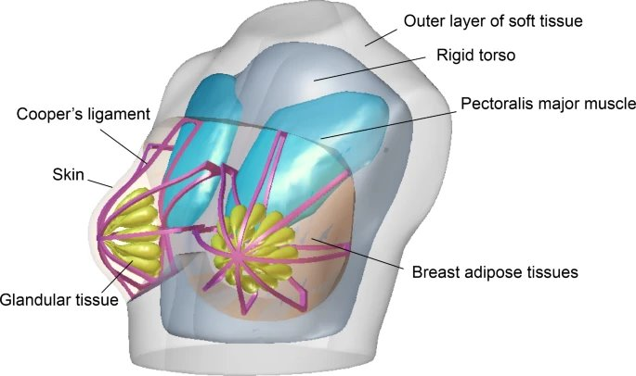
Cooper’s Ligaments Support
Fibrous support structures in the breast
Simplified support bands
Three support variants
[6] Chen et al. 2025
Notes:
Cooper's ligaments are fibrous support structures in the breast.
I implemented them as simplified Cooper-like support terms. These apply restoring tractions to selected regions, so the model can test the mechanical influence of additional support without modelling every ligament.
Again in literature is divided around the exact orientations of these ligaments so I implemented three different variants

Slide 22
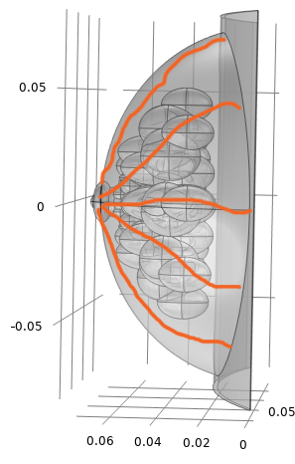
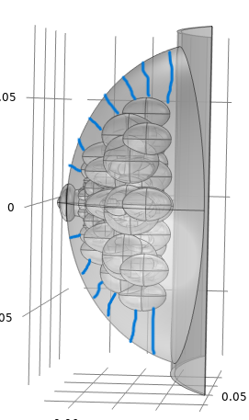
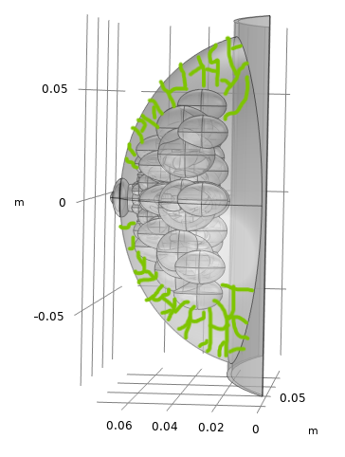
3 orientations:
Nipple-chest Skin-glandular Skin-glandular dense
Notes:
Can variate across women

Slide 23
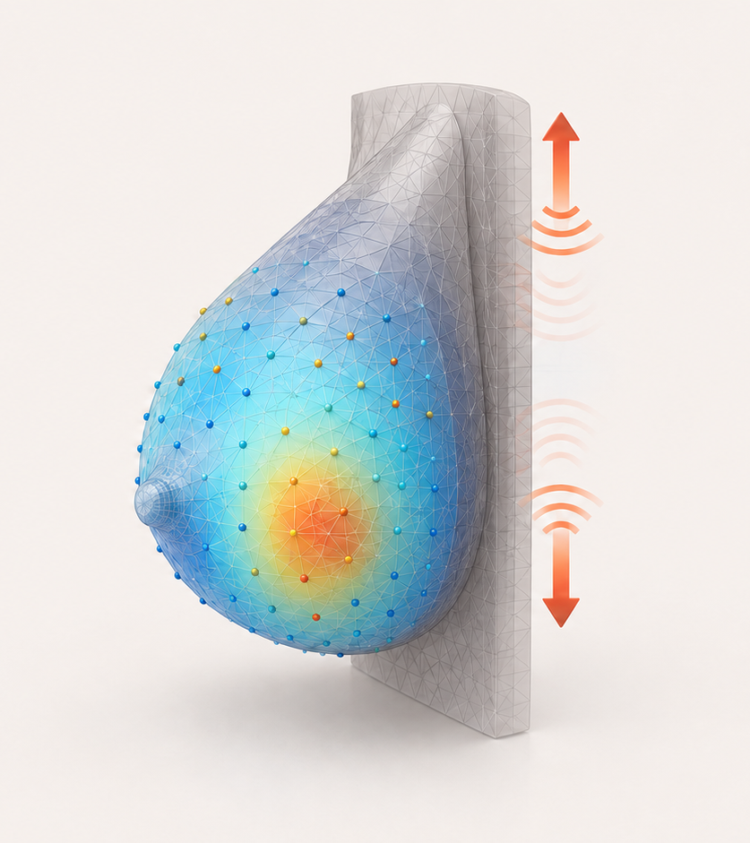
Dynamic Loading and Surface Evaluation

Slide 24
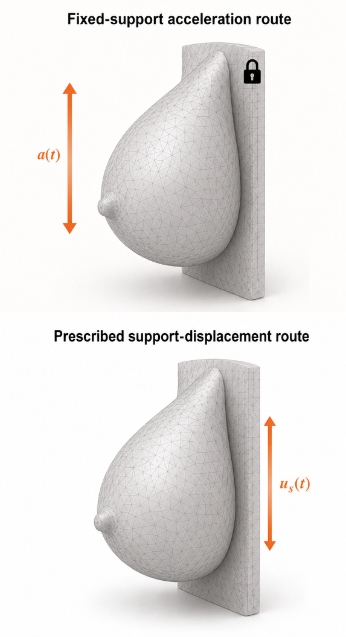
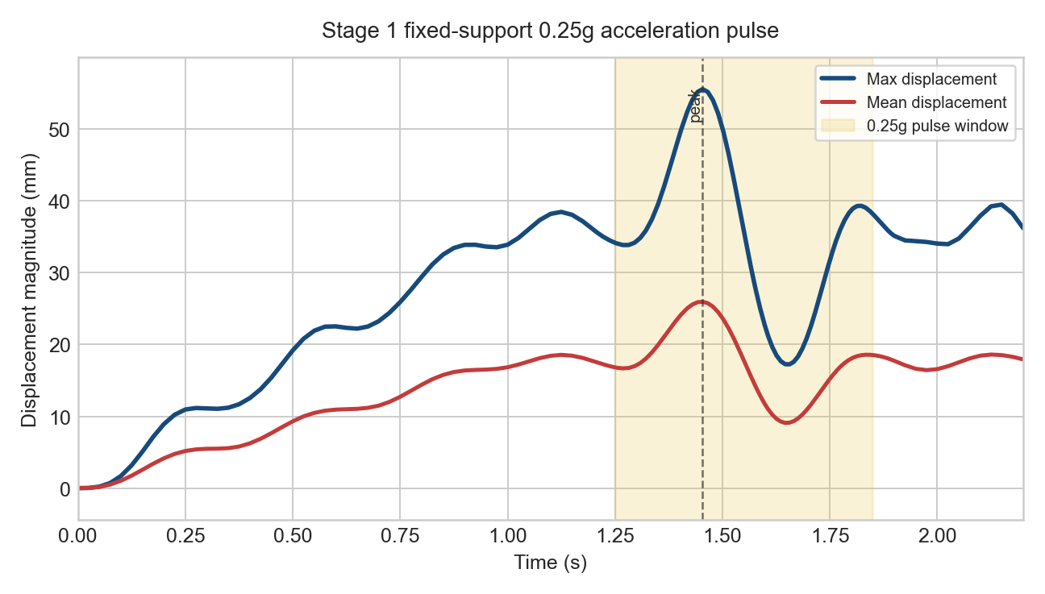
Dynamic Loading
Fixed-support acceleration route
Breast excited by acceleration pulse
Prescribed support-displacement route
Breast motion by moving posterior support
Displacement over time
Notes:
The main dynamic route used a fixed posterior support and applied an acceleration pulse to the breast volume. This can be interpreted as a small push to the breast in the upper direction were the patients stands still
I also prepared a prescribed support-displacement route. In that case, the posterior support itself moves smoothly up and down. This is comparable with a jump like motion, as if the patient makes a small jump
Surface response evaluated over time:
The important output is not only the final deformed shape, but the time-dependent response. The plot shows how the displacement magnitude changes over time. The yellow region marks the acceleration pulse window, and the peak response occurs during or shortly after this excitation.

Slide 25
Surface Evaluation
EWS-relevant output: Surface motion
Free outer breast surface
Displacement landmark metrics
Only vertical displacement
Notes:
The key point is that EWS would measure the outside of the breast, Therefore, I focused the post-processing on the free outer surface instead of only looking at internal model quantities.
I used displacement magnitude of signed landmarks on the breast averages to describe the surface response over time.
For now, I only looked at vertical displacements of these landmarks since that is the most influencent direction but the model is also able to extract the other 2 directions.

Slide 26
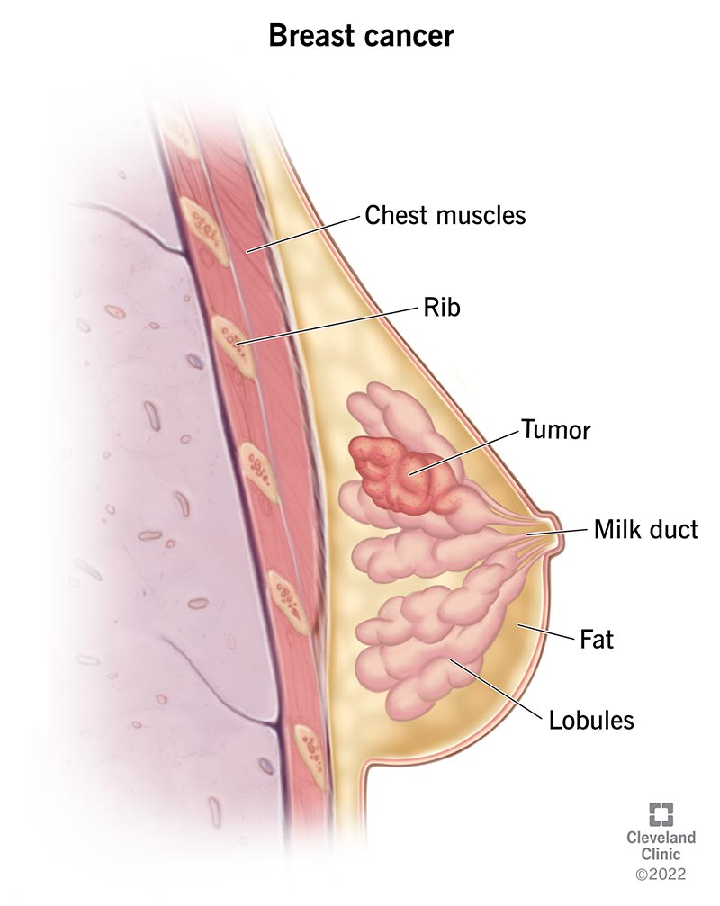
Tumor Implementation

Slide 27
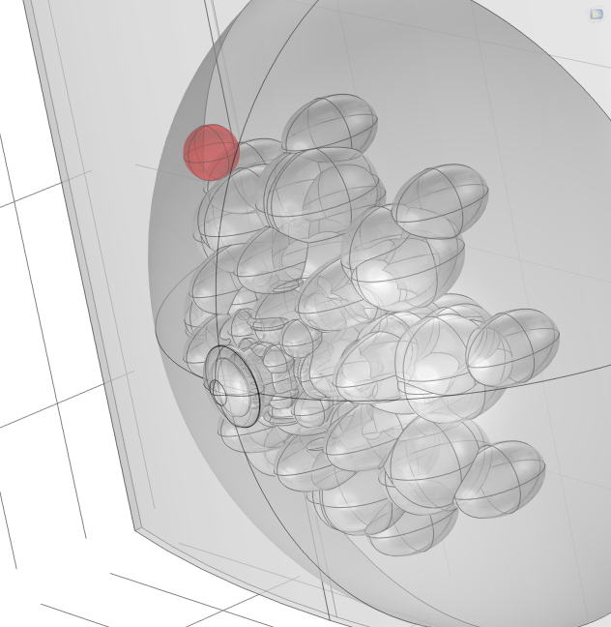
Tumor Implementation
Spherical tumor mask
Local stiffness contrast ~100kPa
Multiple sizes and locations
Build-level placement check
Notes:
For the tumor route, I implemented an analytic spherical material overlay.
It’s a local spot in the breast where the stiffness is adjusted to e.g. 100 kPa to represent the tumor
The tumor can be adjusted in size and location throughout the breast
And I prepared some different variants of model builds with a tumor inside.

Slide 28
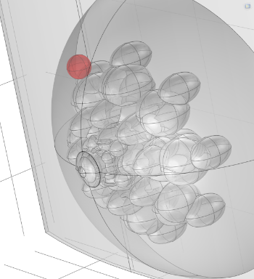
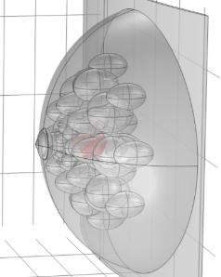
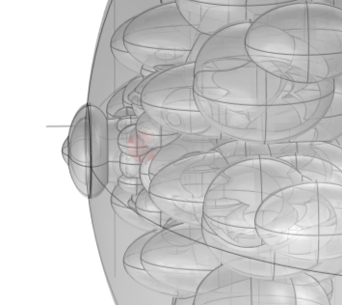
Examples: Big (r=10mm) – Central Small (r=3mm) – Subareolar Medium (r=6mm) – Upper-outer
Notes:
The red regions show the tumor overlays placed inside the existing COMSOL breast model.
And the 3mm

Slide 29
Main Model Development Findings
Component | Main finding | Influence
Skin/material stiffness | Dominant displacement effect | ++
Outer shape/asymmetry | Changes geometry and surface-evaluation context | +
Dynamic loading route | Strongly affects motion interpretation | ++
Cooper’s ligaments support | Small effect in current route | -
Tumor overlay | Placement implemented; more solves needed | ±
++ strong effect | + relevant effect/context | ± implemented, limited quantitative evidence | - small effects
Notes:
Skin and material parameters and the different dynamics loadings showed the biggest influence on the model,
While e.g. the Cooper’s ligaments showed the least effects on the displacement
And for the tumor overlays still needs more solves to validate it fully.

Slide 30
Current Limitations and Future Work
Limited local computation capacity
Faster environment needed
Larger / higher complex sweeps
Tumor cases need to be tested
Dynamic loading not yet fully validated
Comparison EWS like surface motion data
Notes:
Computation limitation: all runs on my own laptop and most runs were more than 12 hours for one case
Also, the dynamic loading and tumor cases still need validation with matched simulations and EWS-like surface-motion data.

Slide 31
Conclusion
Reproducible COMSOL FEM workflow developed
Skin and Material settings dominated response
Model ready for future research
Notes:
I build a reproducible COMSOL FEM which can be further used and work more realistically than the previous model
The strongest effect in displacement differences were cause by the skin and material settings
So careful calibration of these tissue stiffness needs to be done, before interpreting surface-motion differences.
Overall, model is ready to be further investigated

Slide 32
References
[1] World Health Organization, “Breast cancer,” 2025. [Online]. Available: https://www.who.int/news-room/fact-sheets/detail/breast-cancer
[2] Conner, K. (2026, June 15). Dense Breasts. https://www.breastcancer.org/risk/risk-factors/dense-breasts
[3] MSc, L. P. S. M. (2019, December 13). What is Mammography? inviTRA. https://www.invitra.com/en/breast-cancer/mamography/
[4] Early Warning Scan, “The early warning scan project,” 2025, accessed: 2026-06-05. [Online]. Available: https://www.earlywarningscan.nl/
[5] TeachMeAnatomy. (2025, November 6). The breasts – Structure vasculature TeachMeAnatomy. https://teachmeanatomy.info/thorax/organs/breasts/
[6] Chen et al., Sci Rep, 2025. DOI: https://doi.org/10.1038/s41598-024-83598-8

Slide 33
Development of a COMSOL Breast FEM Model for the Early Warning Scan
08-07-2026
Daan Kuijpers | Internship project | Catharina Hospital | April – July 2026
COMSOL FEM Breast Model for Early Warning scan

Slide 34
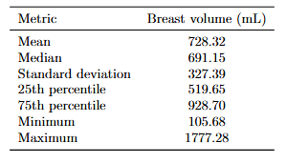
Dataset Catharina Hospital 100 patient's summary
Notes:
Data Catharina Hospital

Slide 35
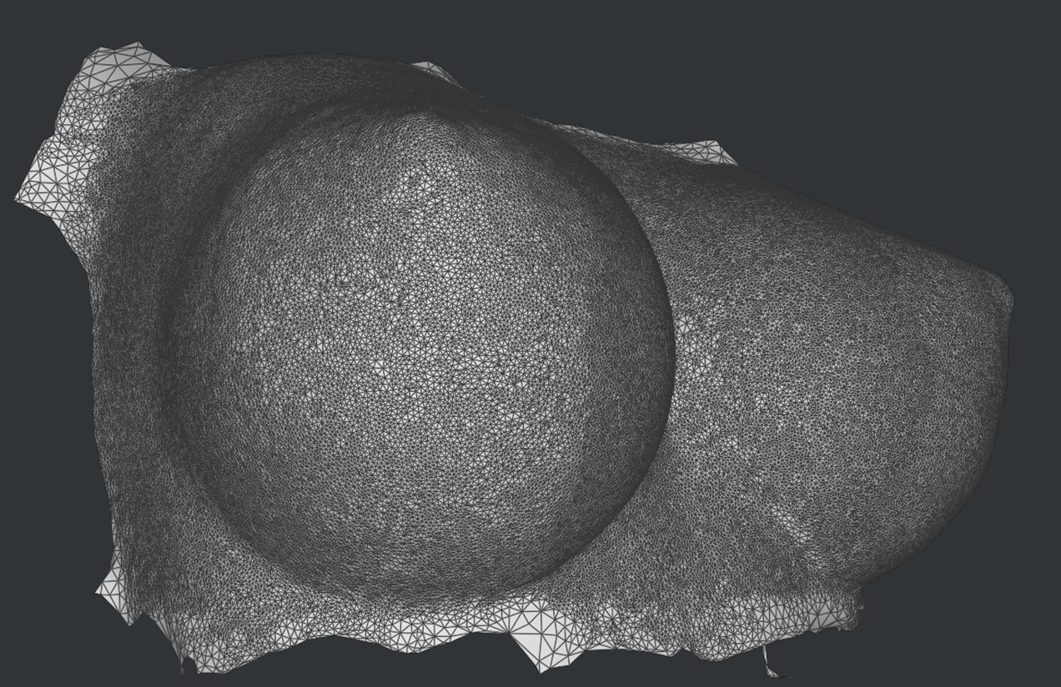
Additional slides
Example mesh made by Early Warning Scan

Slide 36

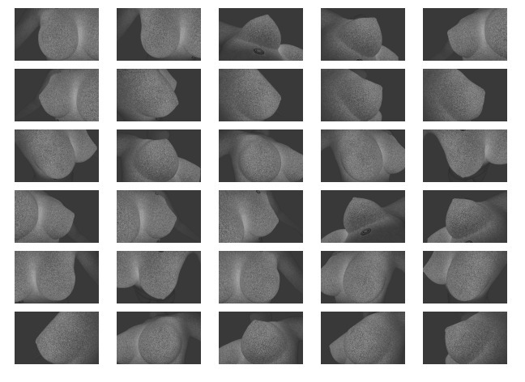
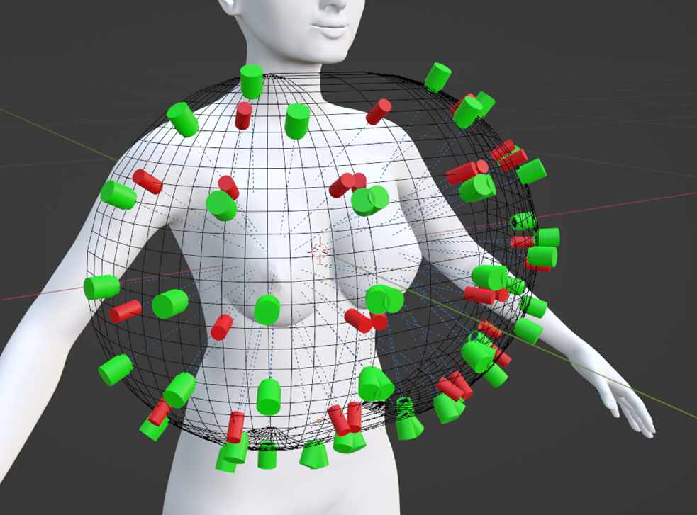
Angles Early Warning Scan (52 Camera’s )

Slide 37
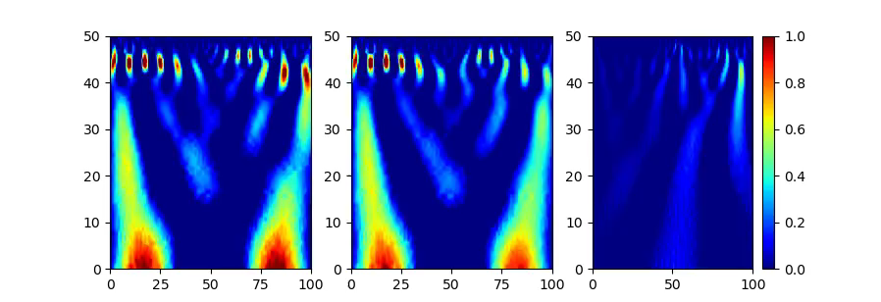

Slide 38
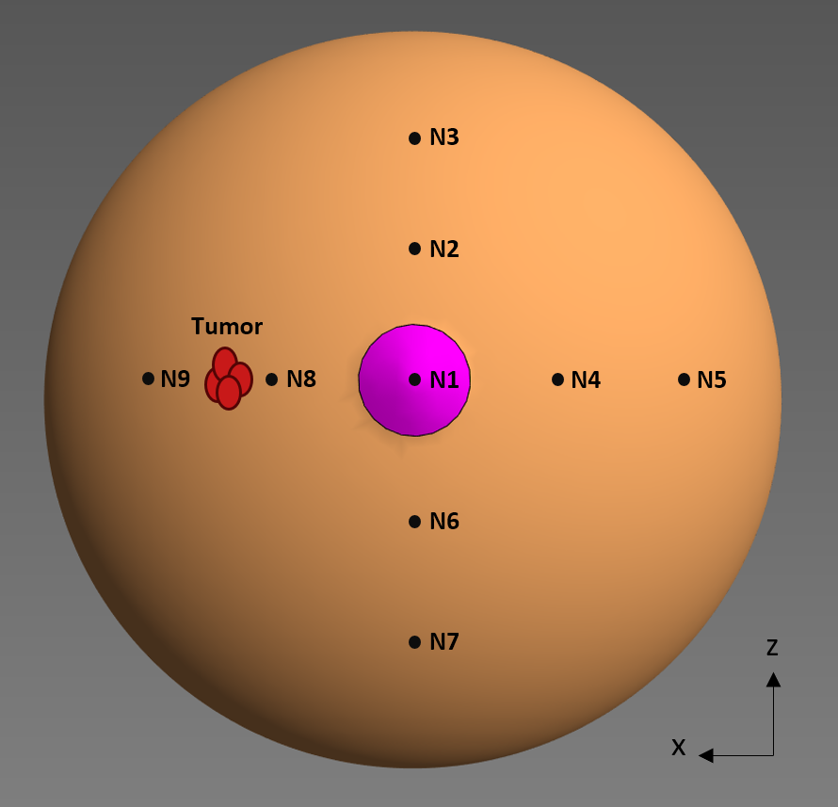
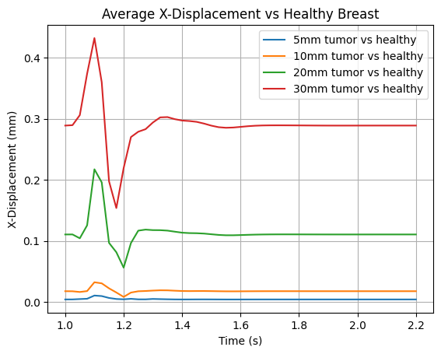


Results previous work (Tim)

Slide 39

Example workbench COMSOL Multiphysics – CKL (ClassKit License)

